Slide 1

RealTrak Train Delay and Scheduling System
Krystal Jordan Nicolo Dannemiller
Paul Stevens Palash Joshi
kjordan13@leomail.tamuc.edu ndannemille@leomail.tamuc.edu
pstevens@leomail.tamuc.edu pjoshi5@leomail.tamuc.edu
Notes:
‹#›

Slide 2
Project Outline
Information and background on the problem that the railways is having that our system solves
What are the goals of the system that helps solve the railways problem?
Scope of the project
RealTrak project development details
Project planning
Discovering and understanding project details
Detailed system analysis
Designing system components
Implementation
System results
Future developments for the system

Slide 3
Information and Background
Our team was contacted by a railway company to design a system that could integrate with their new train scheduling boards. The railway company is reliant on these train scheduling boards to deliver accurate arrival and departure times of the trains at each station.
The system would need to send train times to the scheduling boards which displays times and also make any changes to an arrival or departure time based on any delay that is entered by a railway employee.
Because the railway employs different colored lines that service different stations, the system should allow an employees to enter a delay for a specific train or for an entire line.

Slide 4
System Goals
The goal of the train delay and scheduling system is to provide railway employees with the necessary tools to communicate train delays to the system. The system then updates the database that holds the information about the trains, their schedules, and which lines they run on.
The update of train scheduling based on the delay is done almost instantaneously so that the new schedules can be relayed to the train scheduling boards at each train station.
Railways employees are presented with an easy-to-use user interface (UI) so there is no mistake in which information is needed to enter a delay for a train.

Slide 5
Scope of Project
The railway company can deploy our system on most devices in the form of a desktop application. This allows many different railway employees the ability to enter train delay information.
The train scheduling database is a centralized database that can be implemented on any of the company’s servers. It holds all of the information about which trains the railway company has. It includes such as the stops that each train makes and which lines each train runs on.
The train scheduling information is pulled from the train scheduling database and displayed through the railways company’s new scheduling boards as to update train time schedules.

Slide 6
Project Problem Statement
Train and railway delays are a massive headache for all involved. Delays can have a negative impact on civil and commercial users. Although there is little that can be done to eliminate a delay once it has occurred, quick, accurate, and early reporting of a delay can allow all users involved to plan accordingly and react appropriately. It is important that these reported delays update the train or line being affected so that new arrival and departure times are sent to the train scheduling boards for passengers to view.
It is recommended that a new system be developed and implemented with the railway’s new scheduling boards so railway employees can comminute new train arrival and departure times when a delay has been entered into the system.

Slide 7
Project Planning & Monitoring
Work breakdown structure
Project Planning: includes identifying the problem/need, getting approval for the project, roles and responsibilities, and setting work environment.
Analysis Tasks: includes identifying stakeholders, identifying functional & non-functional requirements through information gathering techniques, and modeling system activities.
Design Tasks: includes designing database schema, user interface, and class diagrams.
Build Tasks: includes system implementation, testing, and deployment.

Slide 8
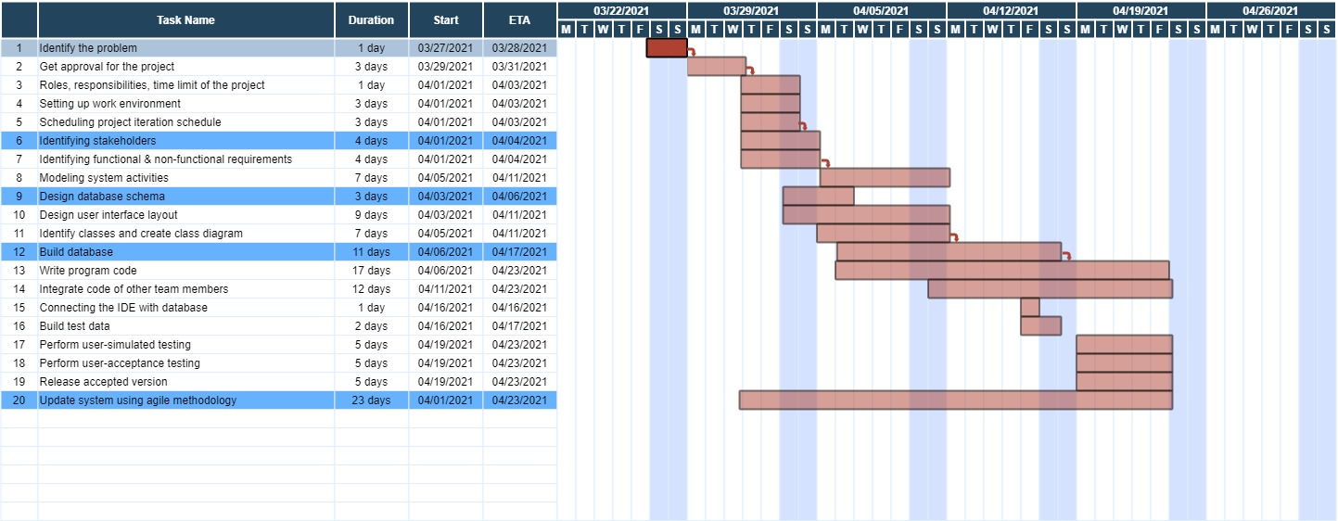
Project Planning & Monitoring
Schedule

Slide 9
Discovering and Understanding Project Details
To identify the key functional requirements of the system, different approaches were used to determine the different users and how they would interact with the system. The different approaches that were used include: user stories and their acceptance criteria, and event decomposition techniques.
The users of the system were broken down into two main groups: railways employees, and passengers. Railway employees are the only users that are able to physically interact with the system while passengers are able to view the system’s results by the updates made to the train scheduling boards. Administrators of the system are users that grant and revoke system access to employees.

Slide 10
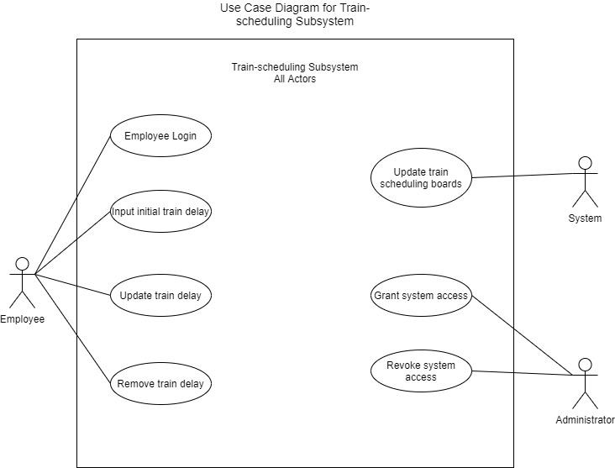
Discovering and Understanding Project Details (cont.)
Train Scheduling System Use Case Diagram

Slide 11
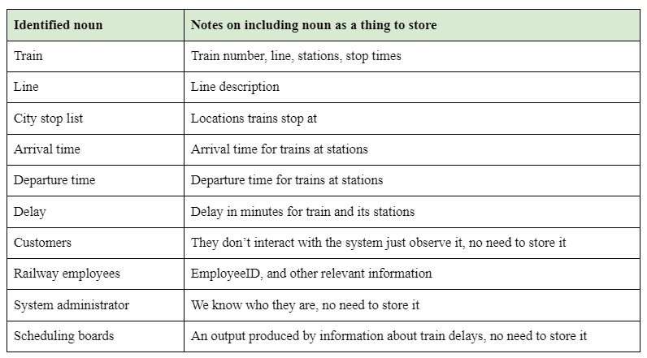
Discovering and Understanding Project Details (cont.)
Identifying the domain classes using the noun technique

Slide 12
Detailed System Analysis
To better understand the users’ needs, the use of fully developed use case descriptions help the system analysts identify how users interact with the system and how to better design the system to help fill those needs.
One of the major use cases in the development of the system is the entry of a train delay into the system. Describing the use case in detail provides the analyst team vital information about how the user and system interact with each other, what information is needed by system to process this interaction, the conditions resulting from the interaction, and what might cause a failure in this interaction.

Slide 13
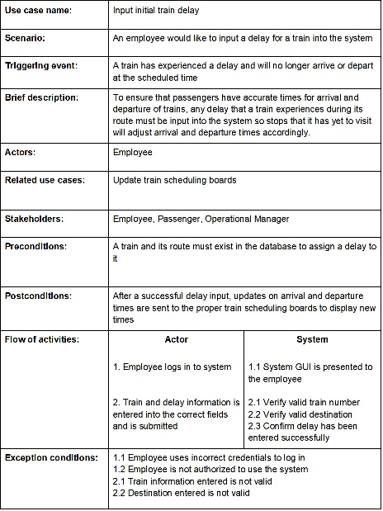
Detailed System Analysis
Input Train Delay Use Case

Slide 14
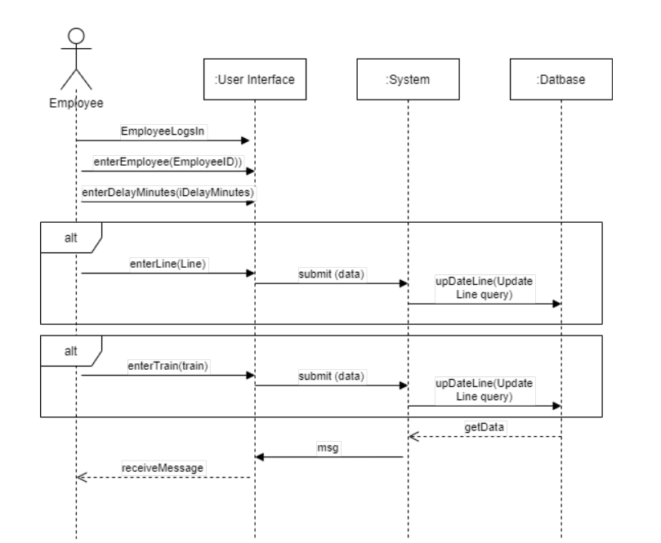
Detailed System Analysis

Slide 15
Designing System Components
The train delay and scheduling system database employs a high-level structure utilizing Microsoft Access. It contains tables, forms, queries, and macros(code) to store the train, line, station, employee, and delay data for the railways company. The appropriate data type for each attribute and the necessary table structure, including the various table relationships, was determined by the analysis of the railways companies business requirements.
Referential integrity was also used in the design of the database table relationships, where needed, so orphan can’t be created.

Slide 16
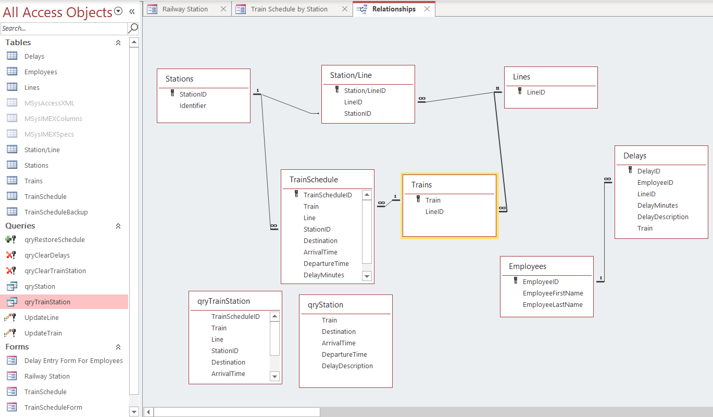
Designing System Components

Slide 17
Implementation
For the implementation of the system, the team utilized Microsoft Access to develop the tables, queries, and user interfaces.
Tables were formed for each of our classes and the relationships were created using the in the Access Relationship window.
The user interfaces were created using forms along with command buttons that once clicked run the update queries to update the system.

Slide 18
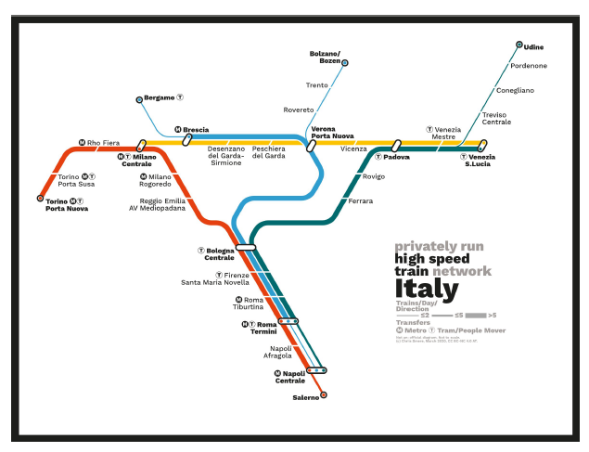
Implementation
To create records for the tables, the team referred to a diagram of the High Speed Train Network Italy to enter lines and stops.
High speed Italy, Chris Smere [April 2020] from http://www.projectmapping.co.uk/Europe%20World/italytrainrailma.html

Slide 19
System Results
The system runs as it was designed but using a database system alone.
The team has run the program a number of times and the system performs consistently. We also, implemented a Restore button to restore the system to its original state to test multiple times.

Slide 20
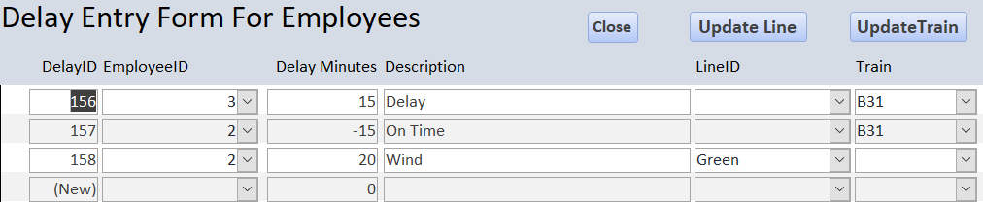
Screenshots of the project
Employee Delay Entry User Interface

Slide 21
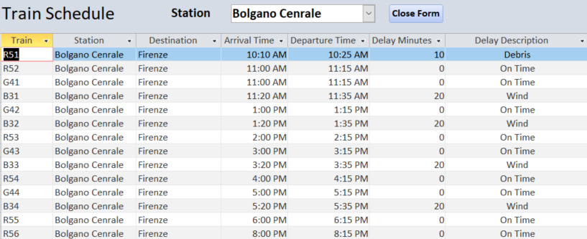
Screenshots of the project
Screen Interfaces for Stations

Slide 22
Future Developments: Notifications
Mobile, email, live browser push notifications would be the next stage of development. Since early, fast, and reliable communication of delays is the main goal of the system, having the ability to communicate delays directly to customers and affected employees is an important next step to meaningfully improve the customer experience.

Slide 23
Future Developments: Functionality
Circular train tracking: Opposed to linear one direction tracking. Reset status to on time when delays are factored out. Automatically connect to rail user accounts; System can track rail schedules for frequently traveled schedules, and also track schedules for purchased tickets.
Currently the database only tracks the trains moving in a singular direction going from point A, to B, to C then resetting at A. While this works for purely circular routes that have no backtracking this is not fully realistic. Some lines might have a portion that goes out and back such as if the train went A, to B, to A, to C, or trains that reverse their route on their way back to the start such as A, to B, to A, to C, to A, to B, to A. The system

Slide 24
References
High speed Italy, Chris Smere [April 2020] from http://www.projectmapping.co.uk/Europe%20World/italytrainrailma.htm
Satzinger, J.W., Jackson, R. B., Burd, S. D. (2012). Systems Analysis and Design in a Changing World, Sixth Edition, Course Technology, CENGAGE Learning .

